Slide 1
Missing Data in Healthcare: Challenges, Comparisons, and Machine Learning Solutions
Meadow Monticello ‘26, Mathematics & Data Science
Faculty Mentor: Dr. Abolfazl Saghafi, Mathematics

Slide 2
Motivations
Missing data is pervasive in healthcare electronic health records (EHRs)
Imputation method choice changes who is “visible” in analysis and affects fairness
Goal: evaluate classical, ML, and deep generative imputation methods in clinically relevant data
Notes:
Skip rows BECAUSE …

Slide 3
Prior Experience with Missing Data
Summer Internship at the Children’s Hospital of Philadelphia
Database, Website, and Internal Data Channel
Biased, unusable, “wasted” data and research

Slide 4
Research Questions and Objectives
Primary question: How do imputation choices affect estimate accuracy and downstream prediction in clinical datasets?
Secondary questions: How do imputation methods affect variable types (continuous/categorical)? Which methods are practical for health settings?

Slide 5
Missing Data Mechanisms: MCAR, MAR, MNAR
MCAR - Missing Completely at Random
Missingness is unrelated to any variable
No systematic pattern
Safest assumption; rare in practice
MAR - Missing at Random
Missingness depends on observed variables
Can be handled effectively with imputation models
MNAR - Missing Not at Random
Missingness depends on unobserved or missing values
Hardest to model; requires assumptions or sensitivity analysis
NOTE: Data mechanism guides imputation strategy
Notes:
Health care example for all 3

Slide 6
Imputation Strategies Compared
Median Imputation
MICE (Multiple Imputation by Chained Equations)
MissForest (Random Forest-based)
GAIN (Generative Adversarial Imputation Network)
EGAIN (Enhanced Gain)
MIWAE (Missing-data Importance Weighted Autoencoder)
Notes:
These six methods represent increasing complexity—from deterministic statistical methods, to iterative machine-learning approaches, to deep generative models.

Slide 7
Overview of Methods (1)
Case Deletion*
Removes rows with missing values (listwise)
Uses available pairs for correlations (pairwise)
Valid only under MCAR
Simple and widely used but discards data
Median Imputation
Replaces missing values with the median of each variable
Simple, fast, deterministic
Resistant to outliers
Does not preserve variable relationships or variance
Used as a baseline comparison

Slide 8
Overview of Methods (2)
MICE
Iterative, model-based imputation
Fits a predictive model for each variable with missingness
Generates multiple plausible datasets (m imputations)
Captures multivariate relationships
Strong performance under MAR
MissForest
Uses Random Forests to predict missing values
Handles nonlinearities and interactions automatically
Works well with mixed variable types
Iterative: refines predictions until convergence
Often high performance with minimal tuning
Notes:
Really explain MICE

Slide 9
Overview of Methods (3)
EGAIN
Extension of GAIN with additional regularization
Stabilizes adversarial training and reduces mode collapse
Improves convergence and robustness on high-missingness data
Produces more reliable imputations than standard GAIN
Better handles complex nonlinear relationships
GAIN
GAN-based model that learns the data distribution
Generator imputes missing values
Discriminator distinguishes real vs. imputed values
Masks guide the discriminator to focus on missing areas
Strong performance when data has complex structure
Notes:
EGAIN introduces an entropy-based regularization term that encourages the generator to maintain diversity in its imputations. This mitigates mode collapse—one of the primary weaknesses of adversarial approaches—and results in more stable, accurate imputations, particularly under high missingness.

Slide 10
Overview of Methods (4)
MIWAE
Variational autoencoder (VAE) framework
Handles missing values directly through masked likelihoods
Importance-weighted objective improves log-likelihood
Scales well to large datasets
Produces probabilistic, distribution-aware imputations
Notes:
Note that MIWAE approximates true conditional distributions better than deterministic ML methods.

Slide 11
Framingham Heart Study Dataset
Longitudinal cardiovascular cohort
Structured tabular dataset
Mix of continuous + categorical variables
Low missingness (ideal for simulating MCAR/MAR/MNAR)
Outcome: TenYearCHD (binary CHD event within 10 years)

Slide 12
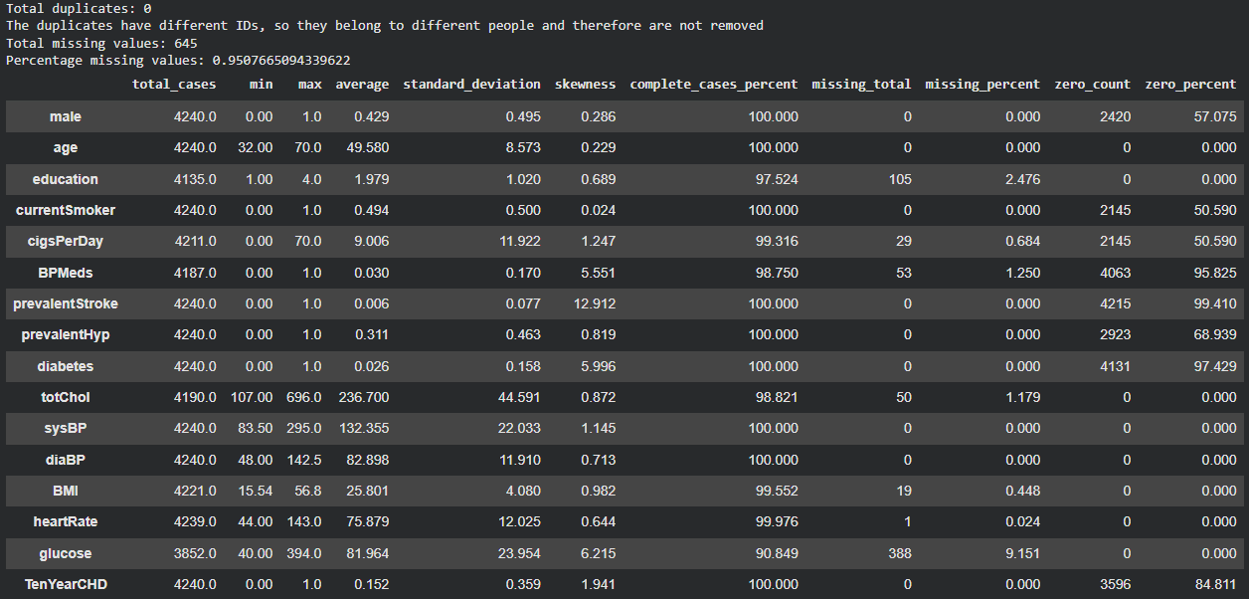
Framingham Heart Study Dataset
TenYearCHD 0% missing
Variable Name | Missing Percent
education | 2.476
cigsPerDay | 0.684
BPMeds | 1.250
totChol | 1.179
BMI | 0.448
heartRate | 0.024
glucose | 9.151

Slide 13
Why This Dataset Works
Real clinical relevance
Clean enough to simulate missingness
Rich feature set for evaluating complex imputation
Easily interpretable results

Slide 14
Colab - Experimental Workflow
Load in dataset
Drop rows with empty fields
Simulate missingness (drop cases using randomseed)
Test the methods on simulated missing data
Compare generated values to true values to measure performance

Slide 15
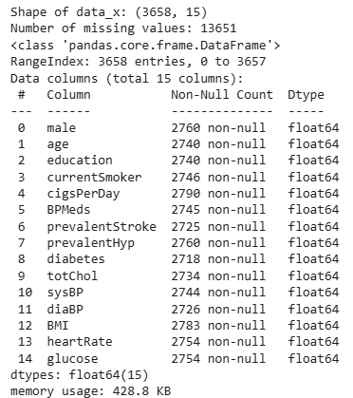
Missingness Simulation
Dropped real missing data (581 rows of 4241)
Set the missing value rate to 25%
Used randomseed “2026”
Produced Missing Data Structure

Slide 16
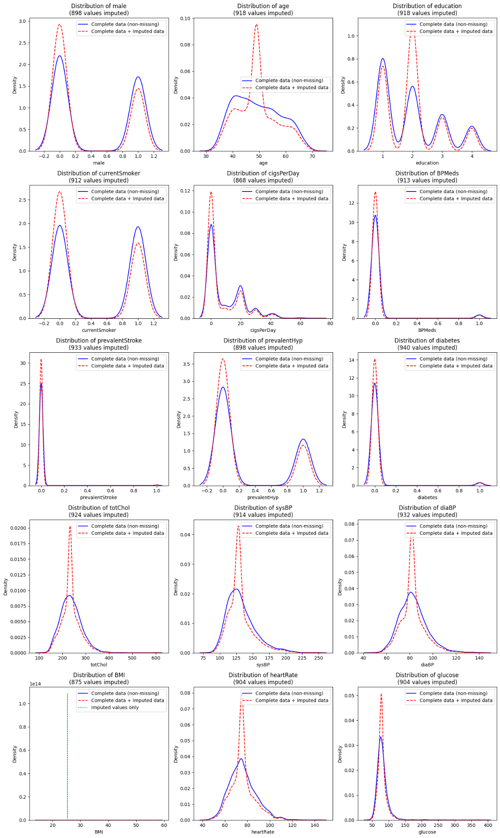
Median
Imputed data has narrow peaks
Preserves central tendency
Higher density at median values, as expected

Slide 17
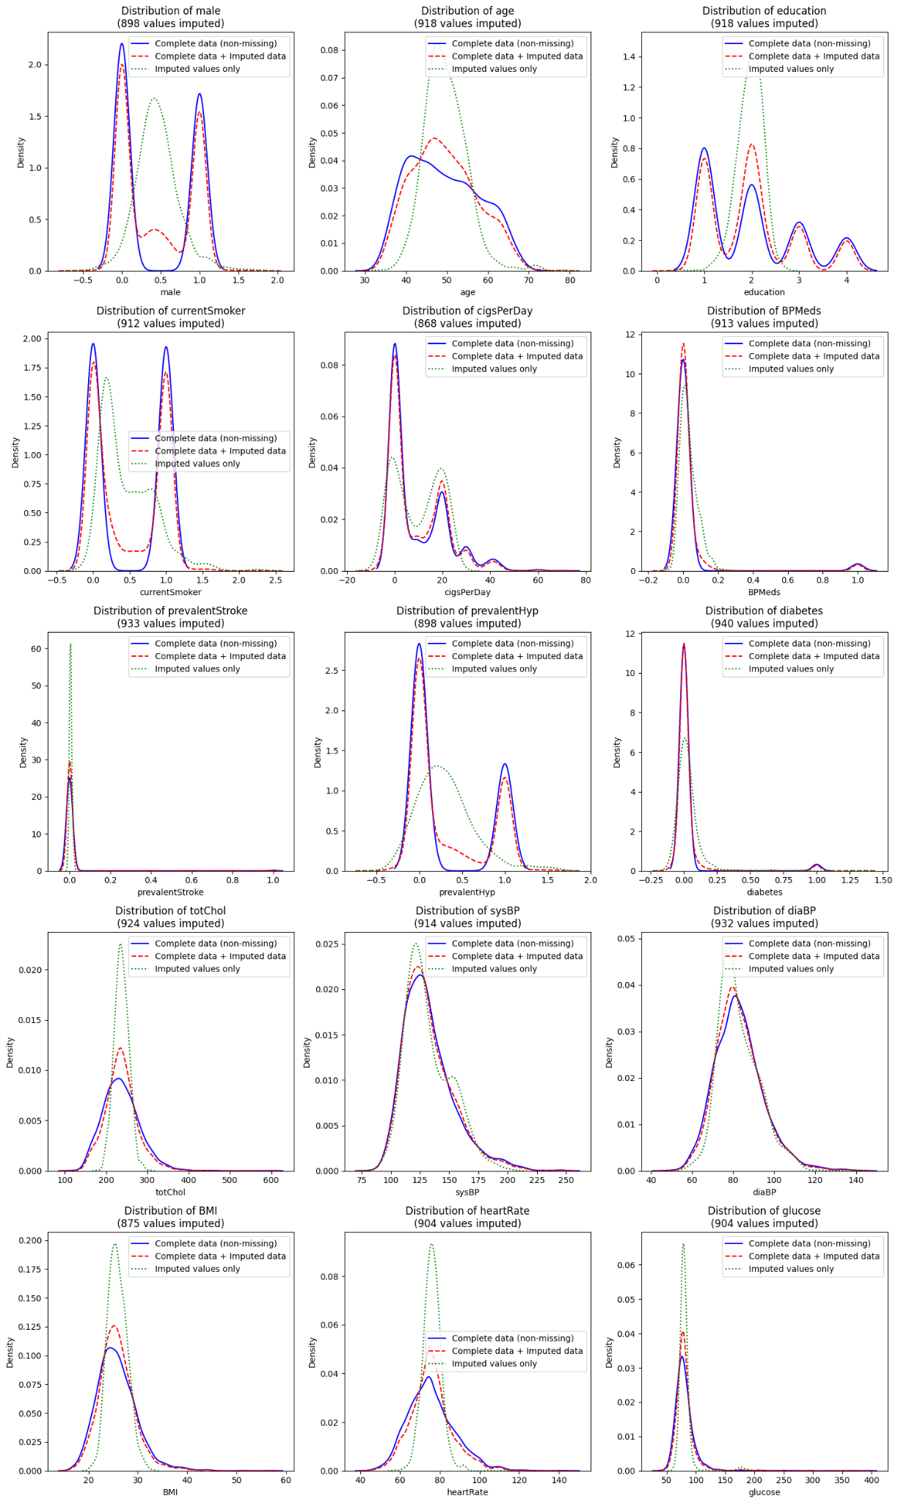
MICE
Central tendencies well aligned
Variability intact
Binary/categorical handled well

Slide 18
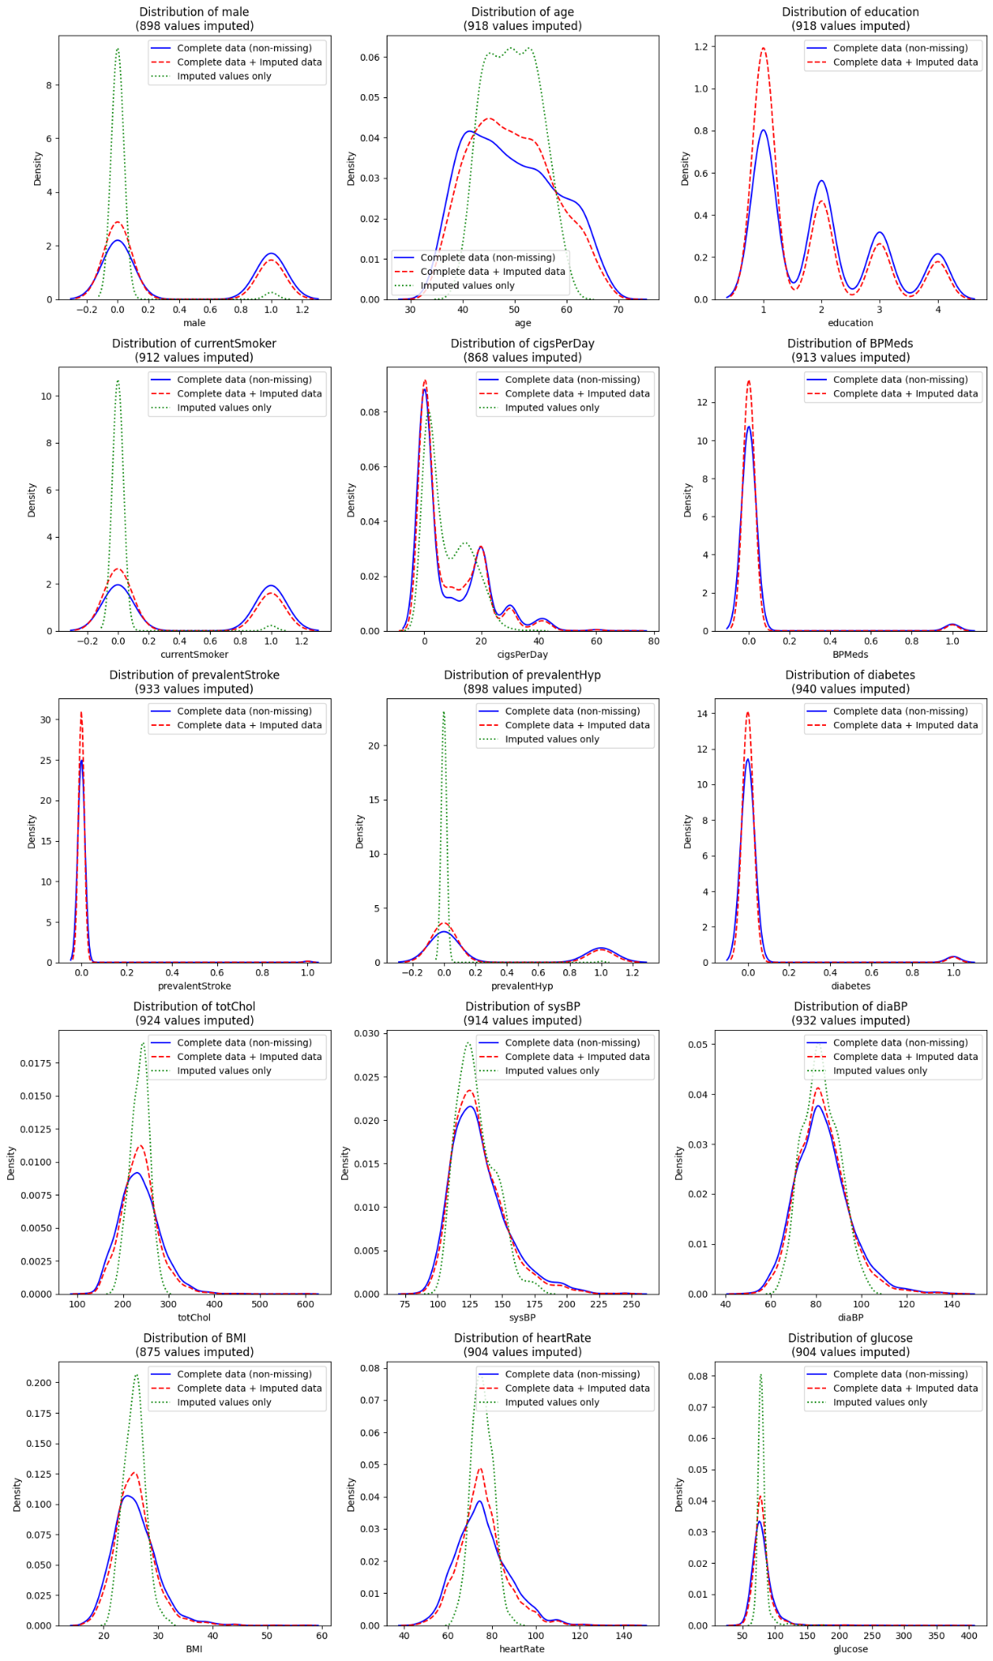
MissForest
Realistic ranges
Imputed values better reflect variability

Slide 19
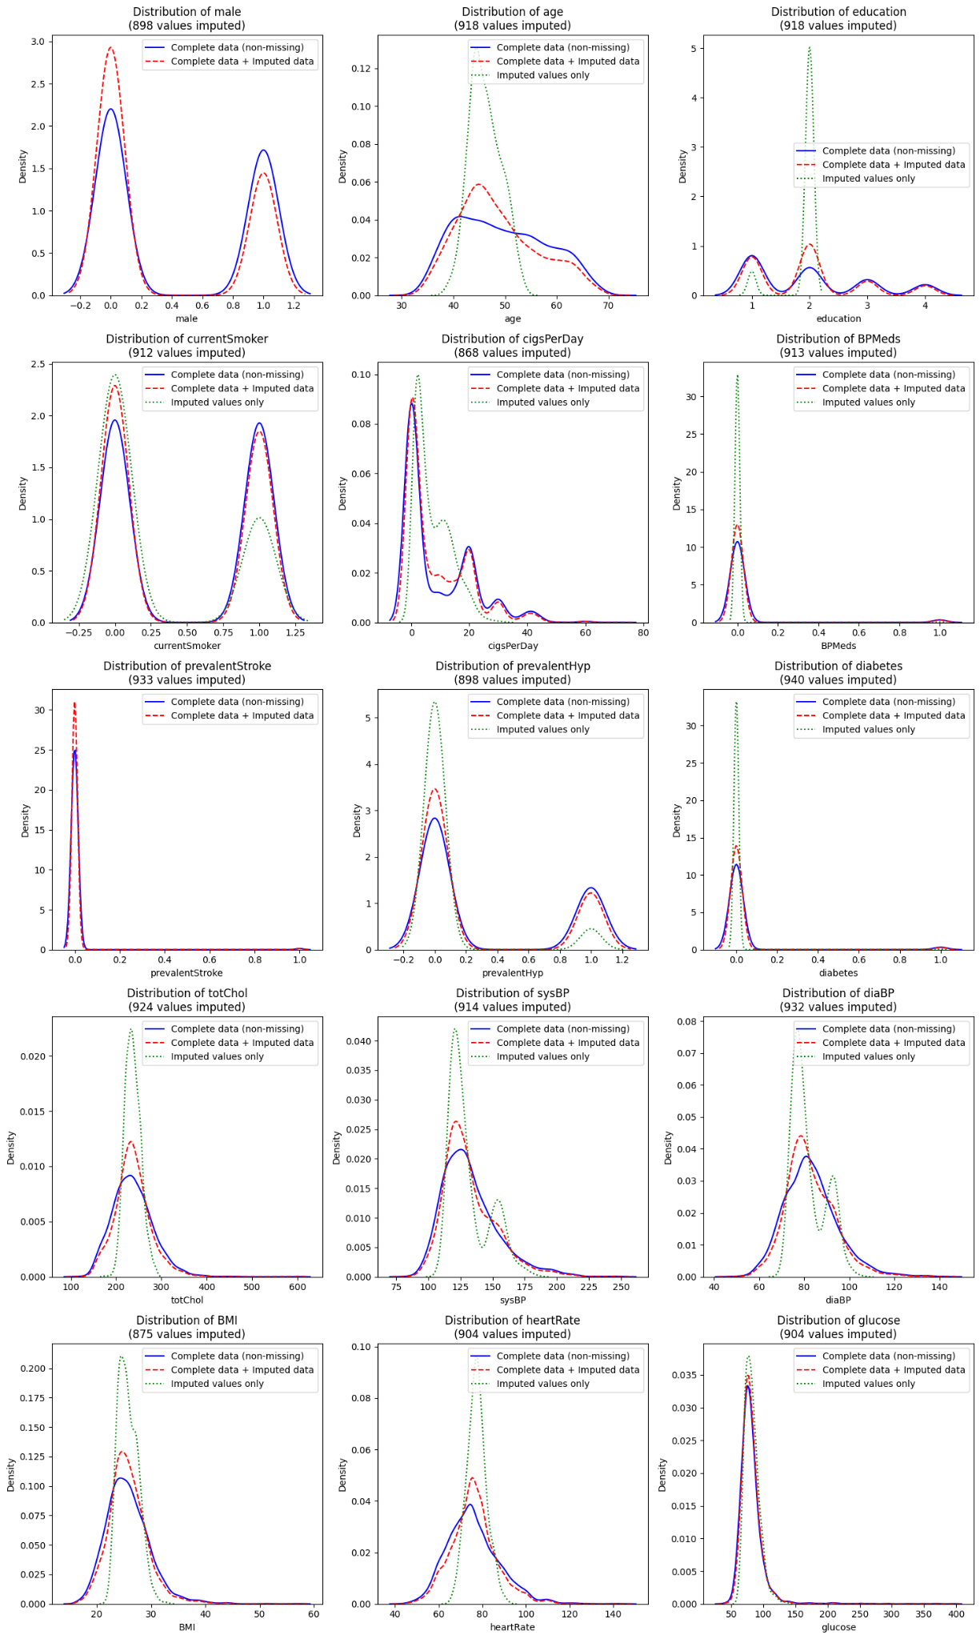
GAIN
Performs well with high missingness rates
Handles mixed data types

Slide 20
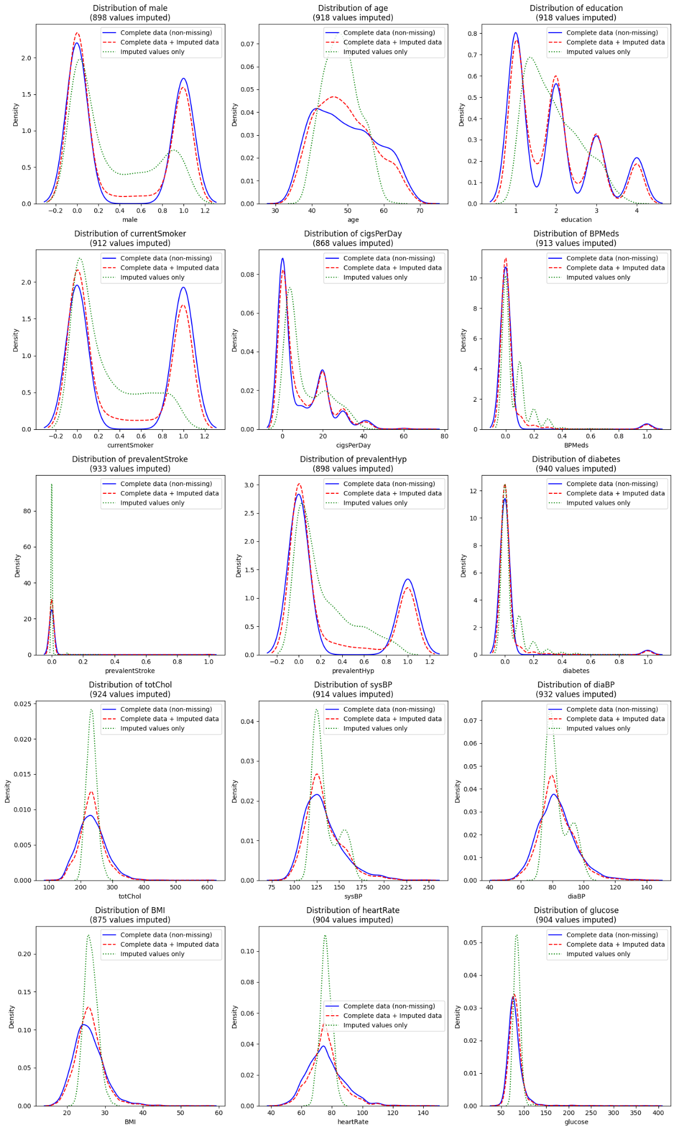
EGAIN
Smooth plotting of imputed values only
Stable, aligned
Notes:
Elaborated on smoothing

Slide 21
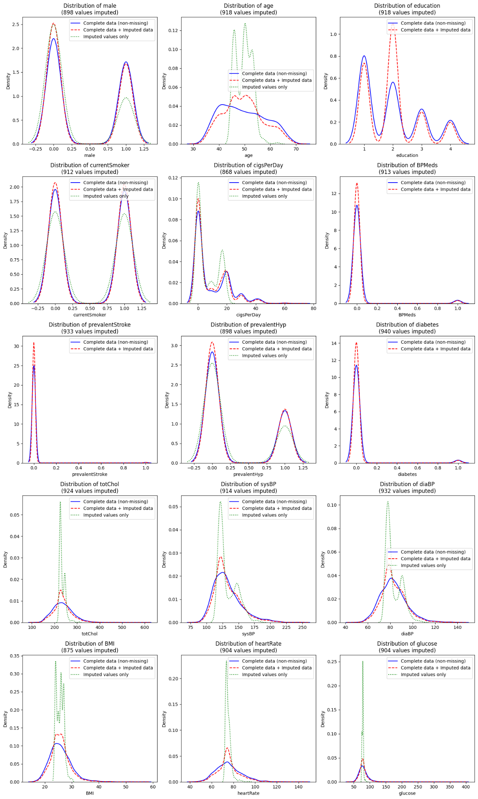
MIWAE
More variability in imputed values
Most accurate with categorical variables

Slide 22
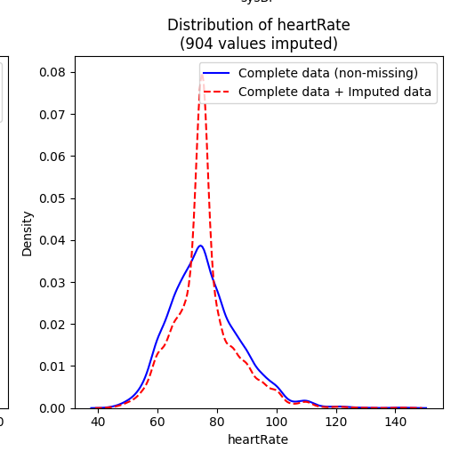
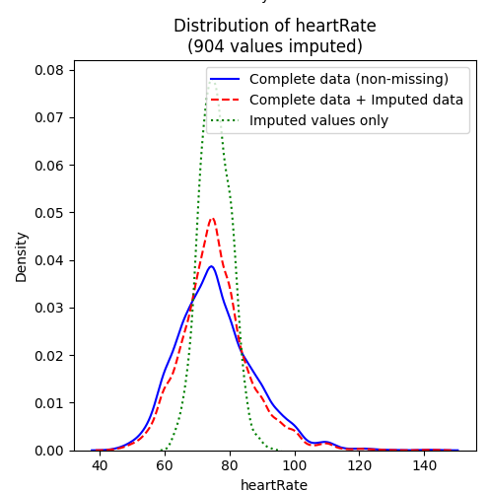
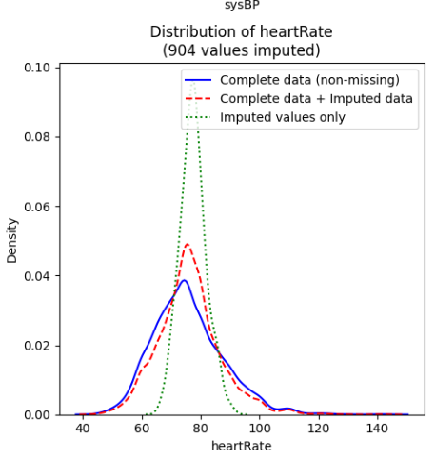
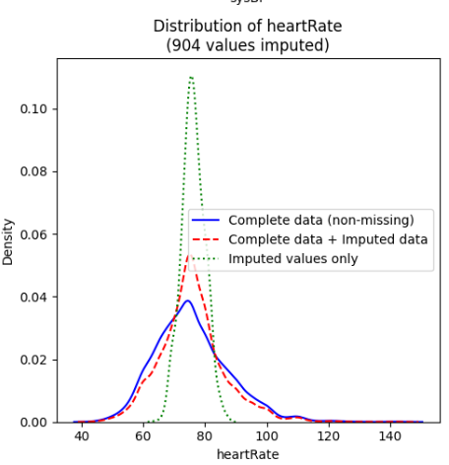
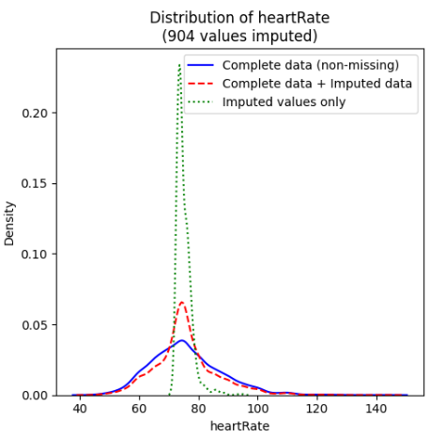
Median
MICE
MissForest
GAIN
EGAIN
MIWAE
Notes:
Graphically it looks like …. But I also have statistical measures outlined

Slide 23
Performance Metrics
Used to assess how well each imputation method reconstructs missing values and preserves the structure of the data
Root Mean Square Error (RMSE)
Used for continuous variables
Measures distance between the predicted and actual values
Lower values = lower deviation from present values
Proportion of Falsely Classified (PFC)
Used for categorical variables.
Measures the proportion of imputed categories that are incorrect.
Lower = better categorical reconstruction

Slide 24
Comparative Metrics
Method | Total RMSE | Mean RMSE | Total PFC | Mean PFC
Median | 102.4088 | 12.8011 | 1.9546 | 0.2771
Mice | 117.1656 | 14.6457 | 1.7306 | 0.2453
MissForest | 123.9 | 15.4875 | 1.8255 | 0.2587
GAIN | 132.832 | 16.604 | 1.6758 | 0.2375
EGAIN | 134.7432 | 16.8429 | 1.8936 | 0.2684
MIWAE | 126.9224 | 15.8653 | 1.777 | 0.252

Slide 25
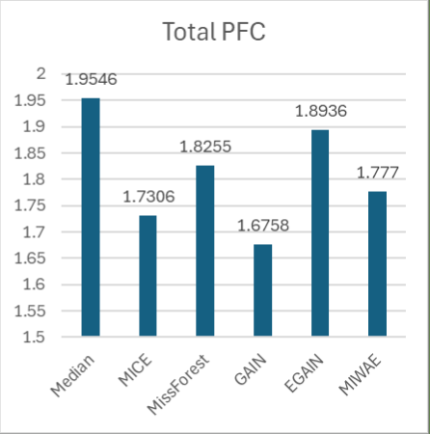
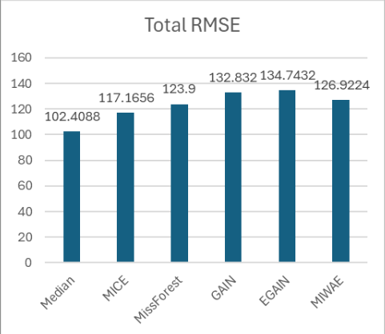
Notes:
Newness of data

Slide 26
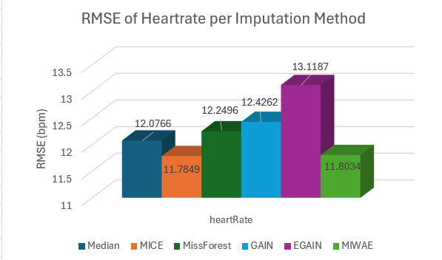
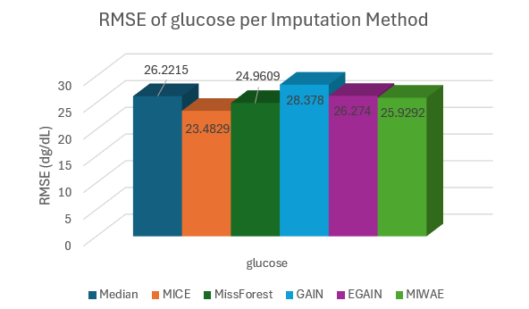
Closer Look at RMSE

Slide 27
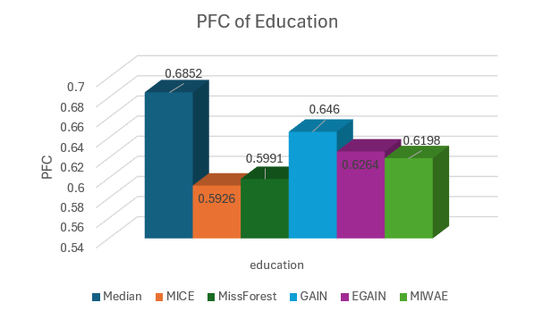
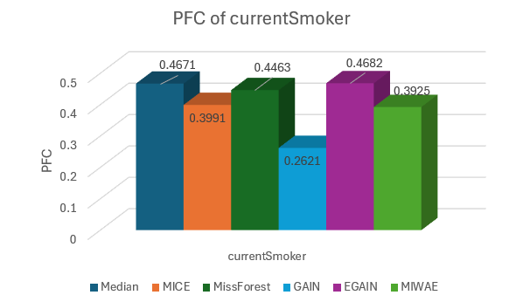
Closer Look at PFC

Slide 28
Takeaways
Frameworks are complete with six diverse imputation methods
Highest accuracy comes with increased computational time, generally
There is more nuance with variable type and imputation behavior
More experimentation needed

Slide 29
Next Steps and Guiding Questions
Run additional hyperparameter tuning on deep models
Validate results with second dataset
Experiment with combining imputation methods

Slide 30
Thank you!
Questions?

